Slide 1
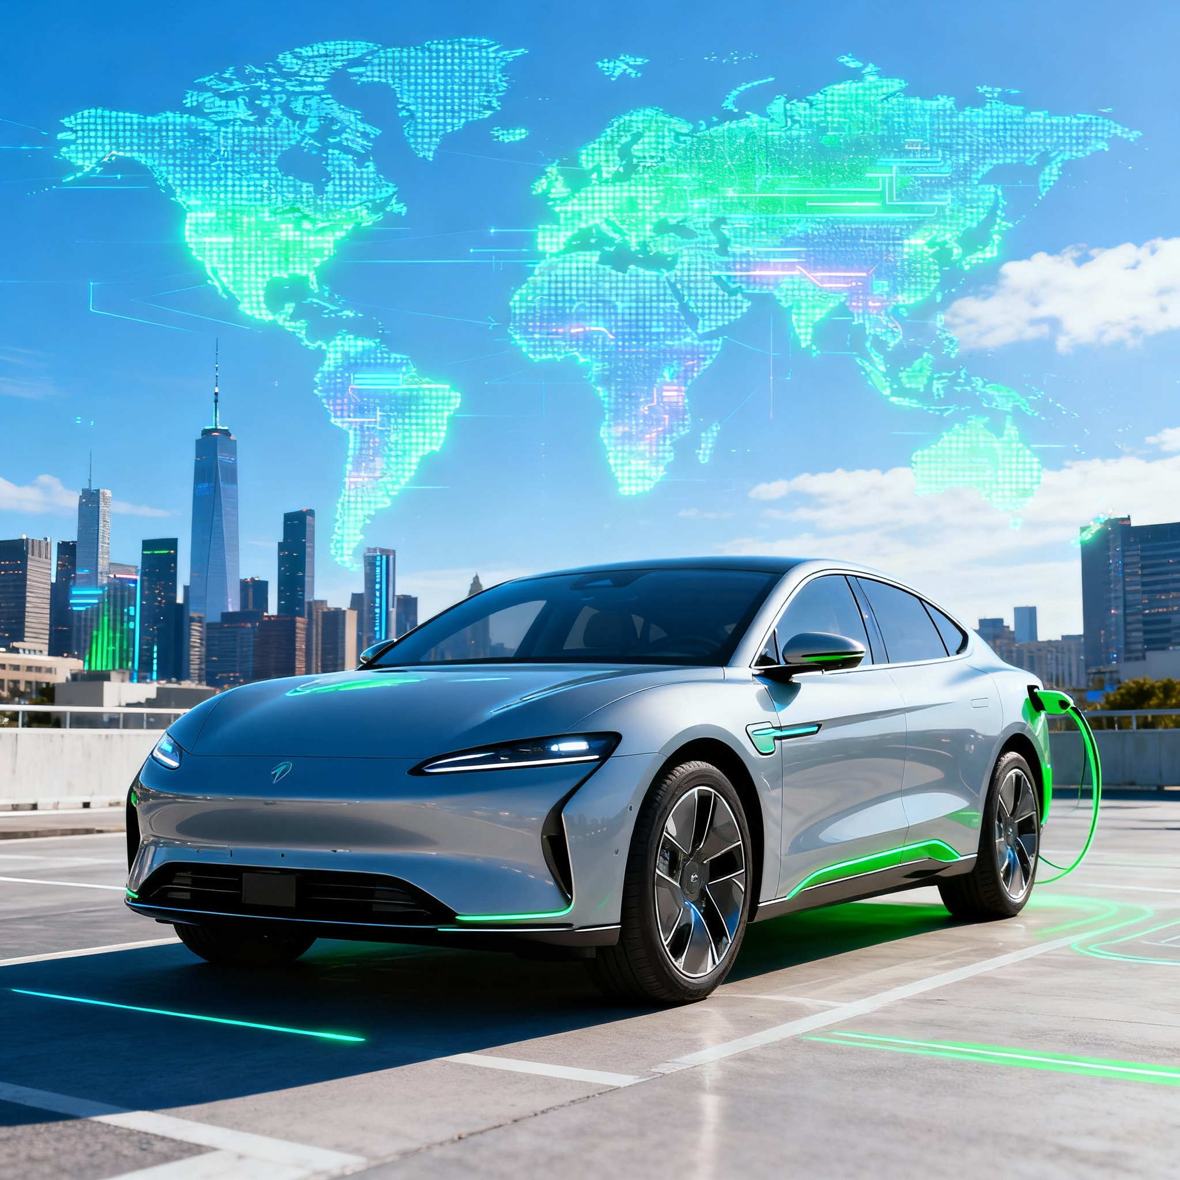
Project on
Global EV Market Analysis Dashboard
Project by :- Nikhil Borade
Notes:
While searching for an interesting dataset, I came across the IEA Global EV Data 2024, published by the International Energy Agency. This dataset includes information about EV sales and stock from countries all over the world. I decided to use it to create an interactive dashboard to explore how electric vehicles are growing globally and what patterns we can find from the data.

Slide 2

Sr.no | Index
1 | Color Palette
2 | Business Objective
3 | Approach and Methodology
4 | Data Preparation
5 | Key Visuals
6 | Dashboard Overview
7 | Dashboard link
8 | Business Insights
9 | Conclusion

Slide 3
1️⃣ Color Palette
Color Name | Color | Description
Blue |  | Graphs
Cyan |  | Buses
Orange |  | Cars
Red |  | Trucks
Pink |  | Vans
Green |  | BEV
Yellow |  | PHEV
Purple |  | FCEV
Gray |  | Developed
Violet |  | Developing
Denotes
Graphs
Vehicle Types
EV Types
Developed vs Developing

Slide 4
2️⃣ Business Objective
Global Comparison
Identify Leaders
Track Growth
Compare EV sales, stock, and
EV Types distribution globally.
Identify top-performing regions and vehicle categories.
Track year-over-year growth trends.
Market Progress
Derive Insights
Analyze developed vs developing market progress.
Find meaningful insights for future EV market growth.
Notes:
To achieve the project goal, I defined a few key objectives:
Compare EV sales and stock across the world.
Identify the top-performing regions and countries.
Track year-over-year growth trends.
Study the difference between developed and developing countries.
Find meaningful insights for future EV market growth.

Slide 5
3️⃣ Approach and Methodology
Objective: To analyze the global Electric Vehicle (EV) market trends, focusing on sales, stock, EV types, regional adoption, and development patterns — to identify growth drivers and future opportunities.
Key Questions Answered:
Which countries and regions lead in EV adoption?
What is the trend of EV types (BEV, PHEV, FCEV) over the years?
How does EV growth differ between developed and developing countries?
Notes:
The main goal of this project was to analyze global EV trends using Power BI. I wanted to understand how EV sales and stock have grown over time, which regions are leading, and which EV types and vehicle categories are most popular. The idea was to get a complete picture of the EV market’s progress worldwide.

Slide 6

4️⃣ Data Preparation
Data Source & Features
Data Cleaning Steps
Dataset Name: IEA Global EV Data
Removed blanks and duplicates
Data Source: International Energy Agency (IEA)
Filtered “EV Sales” and “EV Stock” records
Standardized column names
Key Features Used:
Converted year and value types for visualization
Countries, Parameter(EV Sales, EV Stock)
Vehicles (Cars, Buses, Trucks, Vans)
EV Types (BEV, PHEV, FCEV)
Mode Group (Passenger, Freight)
Developed vs Developing
Value (Target Metric)
Year
Notes:
The dataset I used is the IEA Global EV Data 2024. I cleaned it by removing duplicates, fixing missing values, and renaming columns for clarity. The key columns include Country, Parameter, Vehicle Category, EV Type, Developed vs Developing, and Value. The Value column was my target field — it represents the total EV sales or stock for each region and year. After cleaning, I loaded the data into Power BI for visualization.

Slide 7
5️⃣ Key Visuals
The following charts were selected to represent the core analytical objectives:
Chart
Purpose
Bar Chart – Countries wise total EV count
Compare EV adoption by region
Donut – EV Sales by Vehicle Type
Show share of cars, buses, trucks, vans
Donut – EV Type Share
Display dominance of BEV over PHEV/FCEV
Line Chart – EV Growth Over Years
Track total EV rise year by year
Bar Chart – Passenger vs Freight
Highlight sector contribution
Line Chart – Developed vs Developing
Compare growth patterns
Notes:
I used different visuals to make the dashboard informative and easy to understand. A bar chart compares EV values by region and vehicle category. Donut charts show the share of EV types and vehicle categories. Line charts display how EV stock and sales have grown over time. Another chart compares developed vs developing countries. Together, these visuals clearly show the global EV progress.

Slide 8
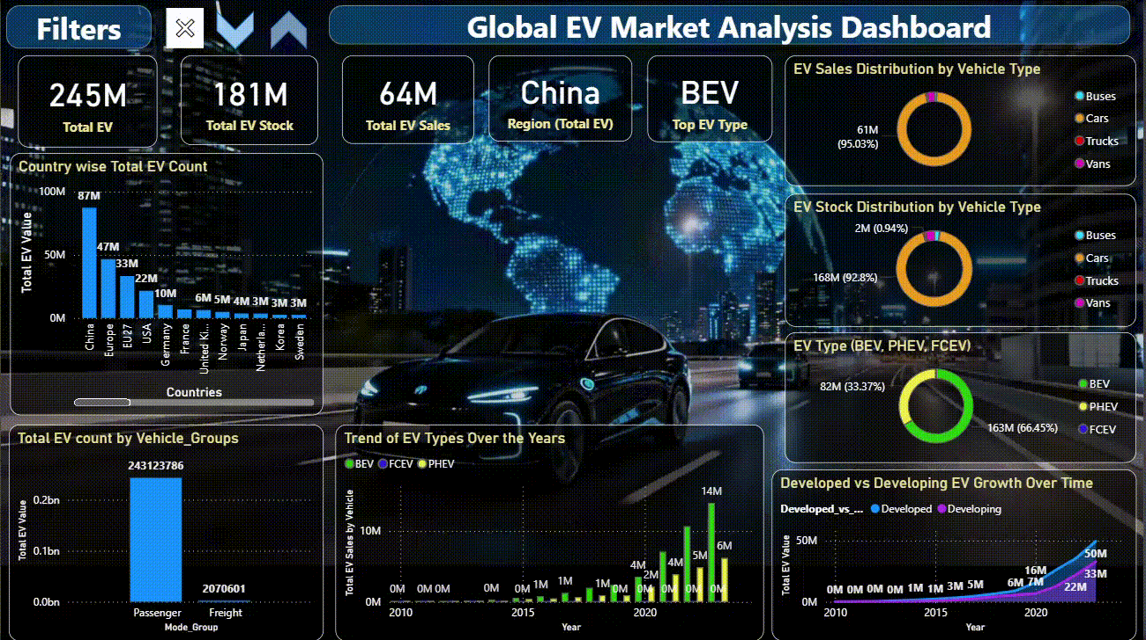
6️⃣ Dashboard Overview
Description: Interactive Power BI dashboard providing a comprehensive overview of EV adoption globally — combining KPIs, charts, and filters for region, EV Type, and Vehicle Type.
Notes:
This is my final Power BI dashboard — it provides a complete view of the global EV market. It includes cards for KPIs like total EV stock, YoY growth, top region, and top EV type. Interactive filters allow you to explore data by region, EV type, or category. The dashboard makes it easy to identify trends and compare EV performance across the world.

Slide 9

7️⃣ Dashboard Link
Click Here

Slide 10





8️⃣ Business Insights
Market Dominance
China and Europe dominate the global EV market.
Vehicle Type
The majority of EV adoption is seen in passenger vehicles..
EV Types Leader
BEV’s lead globally with ~66% share.
Growth Acceleration
EV growth accelerated sharply after 2018.
Market Catch-Up
Developed nations show faster early adoption, but developing regions are catching up.
Notes:
From my analysis, I found some interesting insights:
China and Europe are the top regions for EV adoption.
The majority of EV adoption is seen in passenger vehicles.
BEVs are the most common EV type globally.
EV adoption increased rapidly after 2018.
Developing countries are slowly catching up with EV adoption. These findings highlight how the EV industry is expanding globally and becoming a key part of modern transport.

Slide 11
9️⃣ Conclusion
EV adoption is growing rapidly across the world, with China leading the market.
Passenger vehicles contribute the most to overall EV adoption.
Battery Electric Vehicles (BEVs) are the most preferred type among users.
To support future growth, focus on improving charging infrastructure, battery innovation, and renewable energy integration.
Notes:
This dashboard clearly shows how electric vehicle adoption is growing worldwide, with China leading the way. Passenger vehicles make up the largest share, showing that personal mobility is driving this shift. We can also see that Battery Electric Vehicles are the most preferred type. To keep this momentum going, we need stronger charging infrastructure, better batteries, and more focus on renewable energy.

Slide 12

Thank You

